Slide 1
Storage – RAID
Redundant Array of Independent (Inexpensive) Disks
Controller based RAID technology – 1995
Linux RAID Technology - 2001
Installation
RAID 1 mirrorset example
Mirrorset failure and recovery
Demo's by Lawrence
Waikato Linux User Group
25 Jan 2016
RAID Presentation
Lawrence D'Oliveiro
Ian Stewart

Slide 2
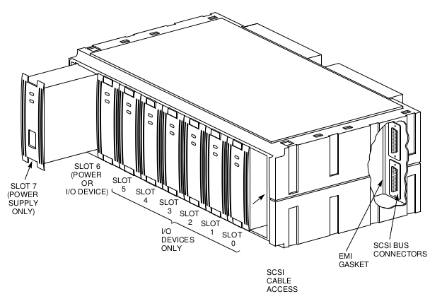
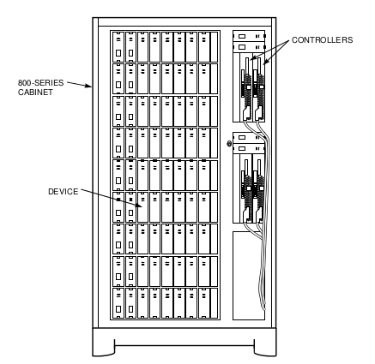
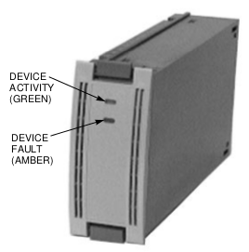
Storage Shelf and Cabinet – 1995 technology
Disk Drive Building Block
14 x Regulators
2 x Disk Controllers
5
4
3
2
1
0
6
7
36 x Disk Drive
Cables to Computers via coupler

Slide 3
Storage
HOST CPU
SYSTEM A
HOST CPU
SYSTEM B
HOST CPU
SYSTEM C
Coupler
Passive
Disk Controller 0
Disk Controller 1
Read or Write-back Cache
Read or Write-back Cache
Failover Communication
1 - 7
0
1
2
3
4
5
1 - 6
2 - 7
0
1
2
3
4
5
2 - 6
3 - 7
0
1
2
3
4
5
3 - 6
4 - 7
0
1
2
3
4
5
4 - 6
5 - 7
0
1
2
3
4
5
5 - 6
6 - 7
0
1
2
3
4
5
6 - 6
6 x SCSI Buses with 6 Disk Drives per SCSI bus. SCSI ID's 0 to 7

Slide 4
Disk Controller. Creating 2 x disk mirrorset
OS sees: M1, D1, D2 – (Does not see Spare sets)
Mirror
Set
RAID1
BUS
M1A
1
2
M1B
3
JBOD
1
4
JBOD
2
5
Spare
Set 1
6
Spare
Set 2
SCSI ID:
0
1
2
3
4
5
0

Slide 5
Disk Controller. Add 2 x stripesets in a mirrorset
OS sees: M1, D1, D2, + M2
Mirror Set 2
RAID1
Mirror
Set 1
RAID1
Stripe
Set 1
RAID0`
Stripe
Set 3
RAID0
BUS
M1A
S1A
S2F
1
2
M1B
S1B
S2A
3
JBOD
1
S1C
S2B
4
JBOD
2
S1D
S2C
5
Spare
Set 1
S1E
S2D
6
Spare
Set 2
S1F
S2E
SCSI ID:
0
1
2
3
4
5
0

Slide 6
Disk Controller. Add 1 x RAID 5 set
OS sees: M1, D1, D2, M2 + R1
Mirror Set 2
RAID1
Mirror
Set 1
RAID1
Stripe
Set 1
RAID0`
Stripe
Set 2
RAID0
RAID
Set 1
RAID5
BUS
M1A
S1A
S2F
R1A
1
2
M1B
S1B
S2A
R1B
3
JBOD
1
S1C
S2B
R1C
4
JBOD
2
S1D
S2C
R1D
5
Spare
Set 1
S1E
S2D
R1E
6
Spare
Set 2
S1F
S2E
R1F
SCSI ID:
0
1
2
3
4
5
0

Slide 7
3 Member Mirror Set. Hot standby backup.
OS sees: MS1 (3 members) or: MS1 (2 members) and MS2 (one member)
Mirror Set 1. 3 x Members
Mirror Set 1. 2 x Members →
M1
M2
M3
← Mirror Set 2. 1 x Member
RAID
Set 1
RAID5`
Stripe
Set 2
RAID5
RAID
Set 3
RAID5
BUS
R1A
R2F
R3E
1
2
R1B
R2A
R3F
3
R1C
R2B
R3A
4
R1D
R2C
R3B
5
Spare
Set 1
R1E
R2D
R3C
6
Spare
Set 2
R1F
R2E
R3D
SCSI ID:
0
1
2
3
4
5
0

Slide 8
RAID 01 vs. RAID 10
OS sees: M0 (RAID 0+1) and S3 (RAID 1+0)
RAID0 + RAID1 →
Mirror Set 0
RAID1
Stripe Set 3
RAID 0
← RAID1 + RAID0
Stripe
Set 1
RAID0
Stripe
Set 3
RAID0
6 x Mirror Sets 1 to 6
RAID1
BUS
S1A
S2F
S3A
M1A
S3A
M1B
1
2
S1B
S2A
S3B
M2A
S3B
M2B
3
S1C
S2B
S3C
M3A
S3C
M3B
4
S1D
S2C
S3D
M4A
S3D
M4B
Note: Diagram simplified for clarity.
A Mirror Set is NOT normally on the same SCSI bus.
5
Spare
Set 1
S1E
S2D
S3E
M5A
S3E
M5B
6
Spare
Set 2
S1F
S2E
S3F
M6A
S3F
M6B
SCSI ID:
0
1
2
3
4
5
0

Slide 9
Disk Controller. Add 1 x Large Stripe Set
OS sees: M1, D1, D2, M2, R1 + S3
Mirror Set 2
RAID0
Mirror
Set 1
RAID0
Stripe
Set 1
RAID1`
Stripe
Set 2
RAID1
RAID
Set 1
RAID5
Stripe
Set 3
RAID0
BUS
M1A
S1A
S2F
R1A
S3A
S3G
1
2
M1B
S1B
S2A
R1B
S3B
S3H
3
JBOD
1
S1C
S2B
R1C
S3C
S3I
4
JBOD
2
S1D
S2C
R1D
S3D
S3J
5
Spare
Set 1
S1E
S2D
R1E
S3E
S3K
6
Spare
Set 2
S1F
S2E
R1F
S3F
S3L
SCSI ID:
0
1
2
3
4
5
0

Slide 10
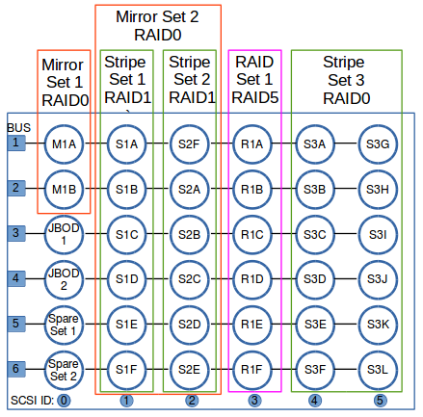
Host Based Mirror set
HOST CPU
SYSTEM A
Coupler
Passive
Disk Controllers 0 & 1
Disk Controllers 2 & 3
Operating System Mirrors Stripeset 3 across two sets of storage controller – Physical Isolation

Slide 11
Linux RAID - mdadm
MDADM: Multiple Device ADMinister
A tool for managing Linux software RAID arrays
Author: Neil Brown
Written in: C
Initial Release: 2001
Operating System: Linux
Latest Stable: 3.3.4 – August 2015
Website: http://neil.brown.name/blog/mdadm

Slide 12
Linux RAID - Install mdadm
lsusb
$ mdadm --detail /dev/md0
The program 'mdadm' is currently not installed.
$ sudo apt-get install mdadm
Reading package lists... Done
Building dependency tree
Reading state information... Done
The following extra packages will be installed:
postfix
Suggested packages:
procmail postfix-mysql postfix-pgsql postfix-ldap postfix-pcre sasl2-bin
dovecot-common postfix-cdb postfix-doc
Recommended packages:
default-mta mail-transport-agent
The following NEW packages will be installed:
mdadm postfix
0 upgraded, 2 newly installed, 0 to remove and 31 not upgraded.
Need to get 1,505 kB of archives.
After this operation, 4,934 kB of additional disk space will be used.
Do you want to continue? [Y/n] y

Slide 13
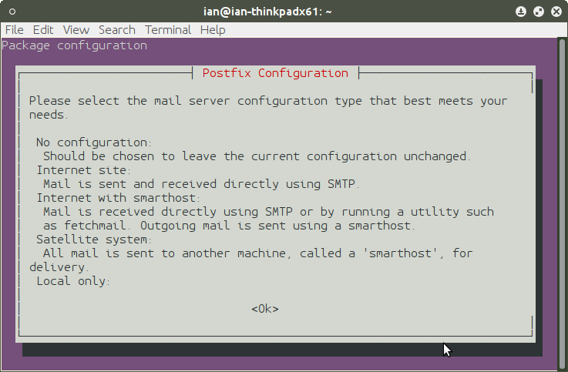
Install mdadm continued...

Slide 14
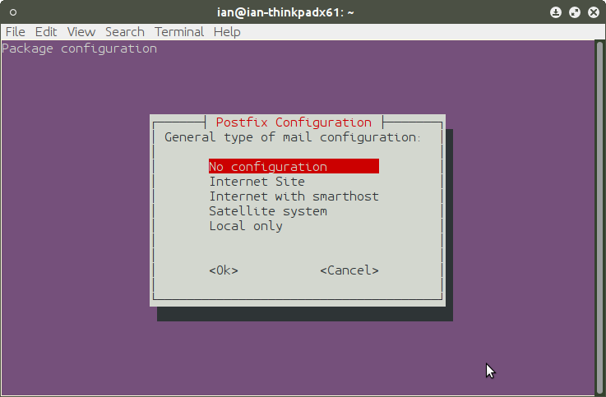
Install mdadm continued...

Slide 15
Install mdadm continued...
lsusb
...
Setting up postfix (2.11.3-1ubuntu1) ...
Adding group `postfix' (GID 132) ...
Done.
Adding system user `postfix' (UID 121) ...
Adding new user `postfix' (UID 121) with group `postfix' ...
...
Postfix was not set up. Start with
cp /usr/share/postfix/main.cf.debian /etc/postfix/main.cf
. If you need to make changes, edit
/etc/postfix/main.cf (and others) as needed. To view Postfix configuration
values, see postconf(1).
After modifying main.cf, be sure to run '/etc/init.d/postfix reload'.
...
W: mdadm: /etc/mdadm/mdadm.conf defines no arrays.
$ sudo mdadm --detail /dev/md0
mdadm: cannot open /dev/md0: No such file or directory

Slide 16
Gparted has been used to create 2 partitions
lsusb
$ lsblk
NAME MAJ:MIN RM SIZE RO TYPE MOUNTPOINT
sda 8:0 0 111.8G 0 disk
├─ ...snip...
├─sda8 8:8 0 100M 0 part
└─sda9 8:9 0 100M 0 part
# ...but RAID device not created yet...
$ ls /dev/md
ls: cannot access /dev/md: No such file or directory
$ sudo mdadm --detail /dev/md0
mdadm: cannot open /dev/md0: No such file or directory
===
Note: To avoid install of postfix. Use –no-install-recommends
$ sudo apt-get install mdadm --no-install-recommends
Do not consider recommended packages as a dependency for installing.

Slide 17
Create 2 x Member Mirrorset. RAID-1
lsusb
# Create RAID array. 2 Members – RAID-1 Mirroring
$ sudo mdadm --create /dev/md0 --raid=2 --level=1 /dev/sda8 /dev/sda9
mdadm: /dev/sda8 appears to contain an ext2fs file system
size=102400K mtime=Thu Jan 1 12:00:00 1970
mdadm: Note: this array has metadata at the start and
may not be suitable as a boot device. If you plan to
store '/boot' on this device please ensure that
your boot-loader understands md/v1.x metadata, or use
--metadata=0.90
mdadm: /dev/sda9 appears to contain an ext2fs file system
size=102400K mtime=Thu Jan 1 12:00:00 1970
Continue creating array? Y
mdadm: Defaulting to version 1.2 metadata
mdadm: array /dev/md0 started.
$

Slide 18
2 x Member Mirrorset. md0 now exists...
lsusb
$ lsblk
NAME MAJ:MIN RM SIZE RO TYPE MOUNTPOINT
sda 8:0 0 111.8G 0 disk
├...snip...
├─sda8 8:8 0 100M 0 part
│ └─md0 9:0 0 99.9M 0 raid1
└─sda9 8:9 0 100M 0 part
└─md0 9:0 0 99.9M 0 raid1

Slide 19
Mirrorset details...
lsusb
$ sudo mdadm --detail /dev/md0
/dev/md0:
Version : 1.2
Creation Time : Mon Jan 18 11:56:15 2016
Raid Level : raid1
Array Size : 102272 (99.89 MiB 104.73 MB)
Used Dev Size : 102272 (99.89 MiB 104.73 MB)
Raid Devices : 2
Total Devices : 2
Persistence : Superblock is persistent
Update Time : Mon Jan 18 11:56:23 2016
State : clean
Active Devices : 2
Working Devices : 2
Failed Devices : 0
Spare Devices : 0
Name : ian-thinkpadx61:0 (local to host ian-thinkpadx61)
UUID : 75a37b25:2677416e:ca35655e:31ca2c63
Events : 17
Number Major Minor RaidDevice State
0 8 8 0 active sync /dev/sda8
1 8 9 1 active sync /dev/sda9

Slide 20
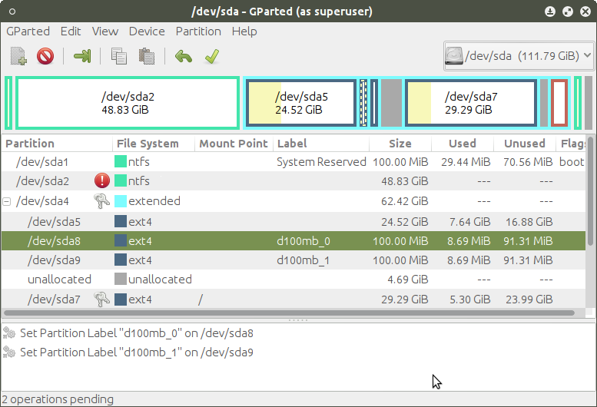
Gparted view of 2 x 100MB drives of mirror set

Slide 21
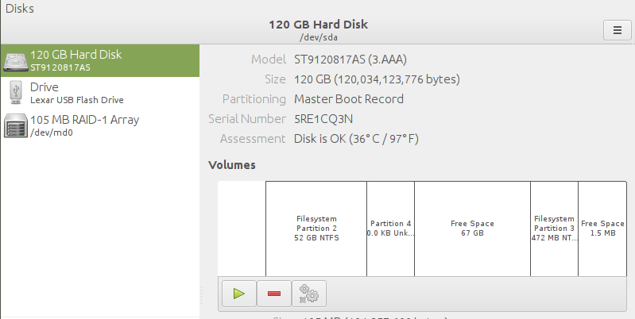
Disk utility view of extended partition...

Slide 22
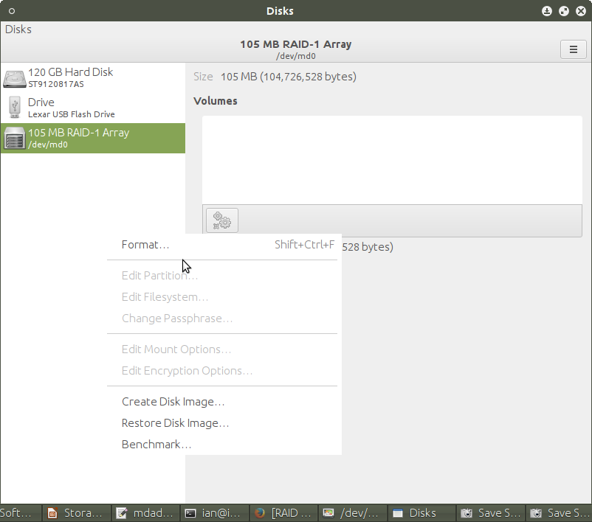
MD RAID Array – Formatting...

Slide 23
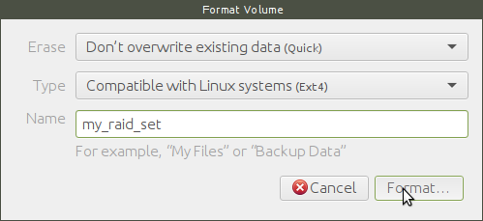
MD RAID Array – Formatting...

Slide 24
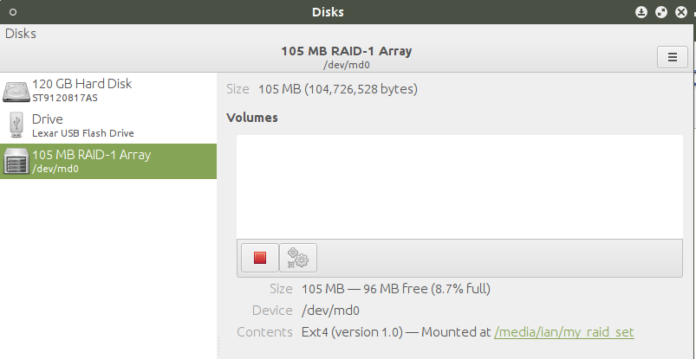
MD RAID Array – Formatted

Slide 25
md0 Mirrorset. Fail one device
lsusb
$ sudo mdadm --fail /dev/md0 /dev/sda8
mdadm: set /dev/sda8 faulty in /dev/md0
$ sudo mdadm --detail /dev/md0
/dev/md0:
Version : 1.2
...snip...
Update Time : Mon Jan 18 12:04:12 2016
State : clean, degraded
Active Devices : 1
Working Devices : 1
Failed Devices : 1
Spare Devices : 0
Name : ian-thinkpadx61:0 (local to host ian-thinkpadx61)
UUID : 75a37b25:2677416e:ca35655e:31ca2c63
Events : 19
Number Major Minor RaidDevice State
0 0 0 0 removed
1 8 9 1 active sync /dev/sda9
0 8 8 - faulty /dev/sda8

Slide 26
md0 Mirrorset. Add file to md0
lsusb
$ ls /media/ian/my_raid_set/
lost+found
$ dd if=/dev/urandom of=/media/ian/my_raid_set/dummy_data bs=1M count=10
10+0 records in
10+0 records out
10485760 bytes (10 MB) copied, 1.03471 s, 10.1 MB/s
$ ls /media/ian/my_raid_set/ -l
total 10252
-rw-rw-r-- 1 ian ian 10485760 Jan 18 12:38 dummy_data
drwx------ 2 root root 12288 Jan 18 12:30 lost+found
$ sudo mdadm --detail /dev/md0
...snip...
Number Major Minor RaidDevice State
0 0 0 0 removed
1 8 9 1 active sync /dev/sda9
0 8 8 - faulty /dev/sda8

Slide 27
md0 Mirrorset. Re-add “faulty”
lsusb
$ sudo mdadm --re-add /dev/md0 faulty
mdadm: added 8:8
$ sudo mdadm --detail /dev/md0
/dev/md0:
Version : 1.2
...snip...
Update Time : Mon Jan 18 12:42:59 2016
State : clean, degraded, recovering
Active Devices : 1
Working Devices : 2
Failed Devices : 0
Spare Devices : 1
Rebuild Status : 24% complete
Name : ian-thinkpadx61:0 (local to host ian-thinkpadx61)
UUID : 75a37b25:2677416e:ca35655e:31ca2c63
Events : 89
Number Major Minor RaidDevice State
0 8 8 0 spare rebuilding /dev/sda8
1 8 9 1 active sync /dev/sda9

Slide 28
md0 Mirrorset. Re-add “faulty”
lsusb
$ sudo mdadm --detail /dev/md0
/dev/md0:
Version : 1.2
..snip...
Update Time : Mon Jan 18 12:43:05 2016
State : clean, degraded, recovering
Active Devices : 1
Working Devices : 2
Failed Devices : 0
Spare Devices : 1
Rebuild Status : 93% complete
Name : ian-thinkpadx61:0 (local to host ian-thinkpadx61)
UUID : 75a37b25:2677416e:ca35655e:31ca2c63
Events : 100
Number Major Minor RaidDevice State
0 8 8 0 spare rebuilding /dev/sda8
1 8 9 1 active sync /dev/sda9

Slide 29
md0 Mirrorset. Re-add “faultly” completed
lsusb
$ sudo mdadm --detail /dev/md0
/dev/md0:
Version : 1.2
...snip...
Update Time : Mon Jan 18 12:43:06 2016
State : clean
Active Devices : 2
Working Devices : 2
Failed Devices : 0
Spare Devices : 0
Name : ian-thinkpadx61:0 (local to host ian-thinkpadx61)
UUID : 75a37b25:2677416e:ca35655e:31ca2c63
Events : 103
Number Major Minor RaidDevice State
0 8 8 0 active sync /dev/sda8
1 8 9 1 active sync /dev/sda9

Slide 30
References
Demos by Lawrence...
https://raid.wiki.kernel.org/index.php/RAID_setup
http://neil.brown.name/blog/mdadm

